Slide 1



Investigating the potential impact of climate variables on the spread of sars-cov-2 (covid-19) in the united states
Gus Lipkin, Florida Polytechnic University
A.K.M. Azad Hossain, Assistant Professor, University of Tennessee at Chattanooga

Slide 2
Outline
Introduction
Literature review
Objective
Data selection
Data sources
Methodology
Results and Analysis
Discussion and Conclusions
Acknowledgements

Slide 3

Introduction

Slide 4






Slide 5

Since COVID-19 is spread through close contact, do any climate variables influence spread?

Slide 6

Literature review

Slide 7


Association of Social Distancing, Population Density, and Temperature With the Instantaneous Reproduction Number of SARS-CoV-2 in Counties Across the United States
Motivation: In July 2020, COVID-19 was relatively new and the researchers thought that maybe the nicer weather would influence spread
Methods: Choose counties based on established criteria about case count, population, and spread. Calculate the R value, how much a virus spreads, from the data. Perform regressions using the EpiEstim and dlnm packages in R.
Results: The R value increased between 11-20 °C (51.8-68 °F). As social distancing increased, the R value decreased. The higher the population density, the more deaths per 100,000 people.
Conclusions: “social distancing, population density, and daily weather may account for variation in the R_{t} for SARS-COv-2 across the United States.”

Slide 8
Developing Numerical Models to Predict Potential Covid-19 Cases Using GIS and Regressions Incorporating Climate Variables
Motivation: Serena Hollis, a UTC REU student from last summer also had Dr Hossain as her advisor
Methods: Linear and non-linear regressions in JMP using soil and air temperature, soil moisture, and population density with data from Johns Hopkins and Copernicus
Results: Population density and air temperature have the greatest effect.
Conclusions: The prediction model was more effective for highly populated areas but cases are likely to rise in the future
Improvements: Smaller scale data, consider new variables like social distancing and mask usage

Slide 9

Objectives

Slide 10

Can we choose specific counties to capture the diversity in data and allow us to make customized predictions for county profiles?

Slide 11

Investigate how the spread of COVID-19 cases relates to climate variables such as air temperature, precipitation, and soil moisture.

Slide 12

County selection & strategy and study site

Slide 13
County selection Process

Slide 14




Selection Variables
Total cases
Total cases until vaccine introduction (30/11/2020)
County population
Google Mobility report total grade
Population density
“spread” [total cases / population density]
Mask usage with never, rarely, sometimes, frequently, and always

Slide 15



Selection Criteria
Goal:
Find a sample of counties representative of the country at large
Finding the criteria:
Obtain summary statistics for the selected variables

Slide 16



Selection Method
Choose an offset value large enough to capture all data (max <= mean + offset) && (min >= mean – offset)
Filter data where variables fall inside the given window
If the goal number of counties is not found
If the number of counties found is below the goal, increase the offset value precision (.1 → .01) and reset to the maximum offset
If the number of counties found is above the goal, decrease the offset value (100 → 99)
Repeat this process until counties are found that match the Q1, Median, Q3, and Mean summary statistics and are geographically and statistically separated

Slide 17
Study Site

Slide 18
Key County Data
 | County | Population | Population Density (per square mile) | Total Cases
1 | Pima, Arizona | 1,039,073 | 110 | 118,938
2 | San Francisco, California | 883,305 | 18,790.74 | 38,367
3 | Miami–Dade, Florida | 2,761,581 | 1,000 | 522,734
4 | Tift, Georgia | 40,571 | 155 | 5,046
5 | Cook, Illinois | 5,180,493 | 5,450 | 559,767
6 | Richland, Louisiana | 20,192 | 36 | 2,597
7 | New York, New York | 1,628,701 | 69,467.5 | 140,314
8 | Medina, Ohio | 179,146 | 2,240.87 | 15,744
9 | Spartanburg, South Carolina | 313,888 | 350 | 42,302
10 | Marion, Texas | 9,928 | 28 | 637

Slide 19
Key County Data
 | County | Population | Population Density (per square mile) | Total Cases
1 | Pima, Arizona | 1,039,073 | 110 | 118,938
2 | San Francisco, California | 883,305 | 18,790.74 | 38,367
3 | Miami–Dade, Florida | 2,761,581 | 1,000 | 522,734
4 | Tift, Georgia | 40,571 | 155 | 5,046
5 | Cook, Illinois | 5,180,493 | 5,450 | 559,767
6 | Richland, Louisiana | 20,192 | 36 | 2,597
7 | New York, New York | 1,628,701 | 69,467.5 | 140,314
8 | Medina, Ohio | 179,146 | 2,240.87 | 15,744
9 | Spartanburg, South Carolina | 313,888 | 350 | 42,302
10 | Marion, Texas | 9,928 | 28 | 637

Slide 20
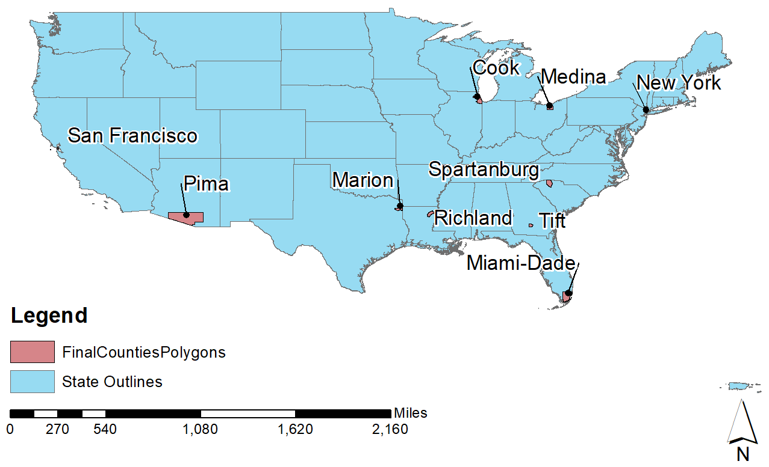
Map of Selected Counties

Slide 21

Data & Sources

Slide 22

Climate Data
Sourced from Copernicus.eu
Geographical time series data for air temperature, precipitation, and soil moisture every day at 3pm
3pm was chosen because it is generally found to be the hottest time of day

Slide 23


COVID-19 Data
Sourced from Center for Systems Science and Engineering (CSSE) at Johns Hopkins University
Time series data of total case count for each county in the United States

Slide 24


Secondary Data
New York Times mask survey data from July 2020
Google Mobility Data is a daily document detailing movement and industry visits (shopping, restaurants, etc)

